Slide 1
Music
Store Analysis
SQL Project
- Parag Uchbagle

Slide 2
Objective
The project aims to analyze a digital music store database using SQL, providing stakeholders with valuable insights for decision-making.
Through SQL queries, it addresses questions regarding geographical growth, purchase power, revenue, genre performance, and music band popularity.
The analysis offers actionable recommendations to drive business growth and optimize performance.

Slide 3
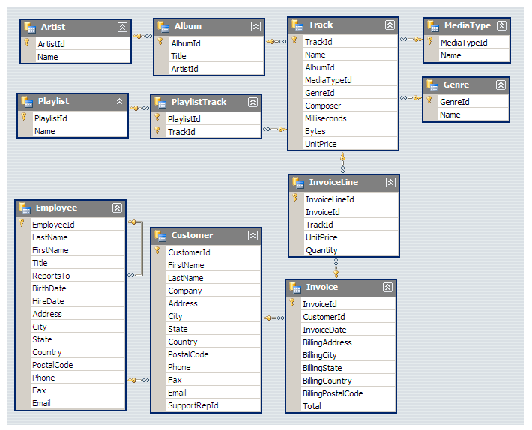
Database Schema

Slide 4
Level Of Queries
EASY
MODERATE
HARD
Includes:
Select , Group by ,
Order By, Limit,
Desc/ Asc
Includes:
Joins, Order by,
Group by, Limits
Inclludes:
CTE(Common table
Expression)

Slide 5
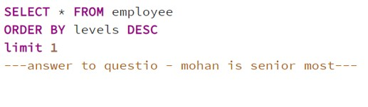

Easy
Question : 1. Who is the senior most employee based on job title?
Query
Output
Answer : Senior General Manager Madan Mohan

Slide 6
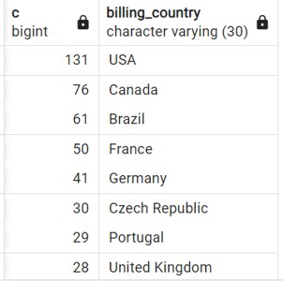
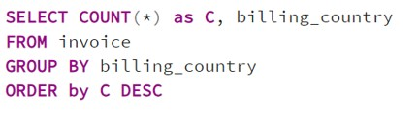
Easy
Question :2. Which countries have the most Invoices?
Output
Query
Answer : USA have the most invoices

Slide 7
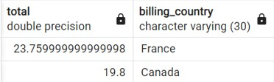

Easy
Question :3. What are top values of total invoice and from which country?
Query
Output
Answer : France with total sum of 23.7

Slide 8
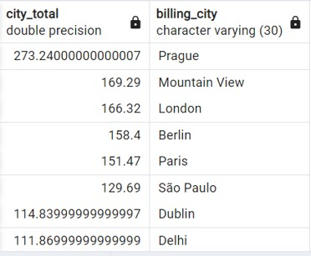
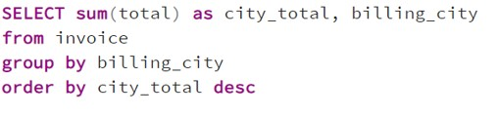
Easy
Question :4. Which city has the best customers? We would like to throw a promotional Music Festival in the city we made the most money. Write a query that returns one city that has the highest sum of invoice totals. Return both the city name & sum of all invoice totals
Output
Query
Answer : From customers of from progue store made most of the money

Slide 9
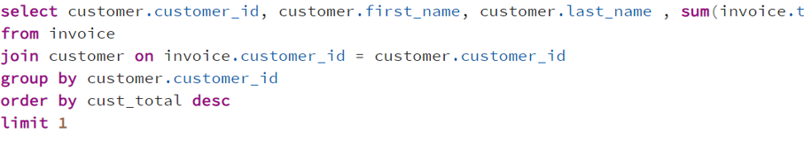

Easy
Question :5. Who is the best customer? The customer who has spent the most money will be declared the best customer. Write a query that returns the person who has spent the most money c
Query
Output
Answer : madhav who had spent $144.54 is the best customer

Slide 10
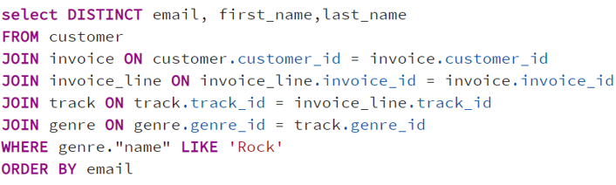
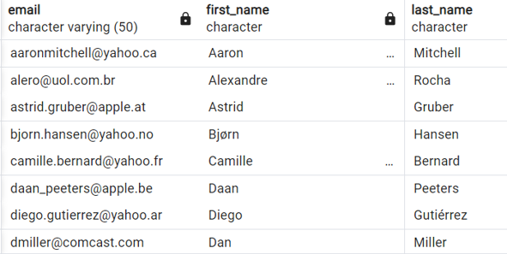
Moderate
Question :1. Write query to return the email, first name, last name, & Genre of all Rock Music listeners. Return your list ordered alphabetically by email starting with A

Slide 11
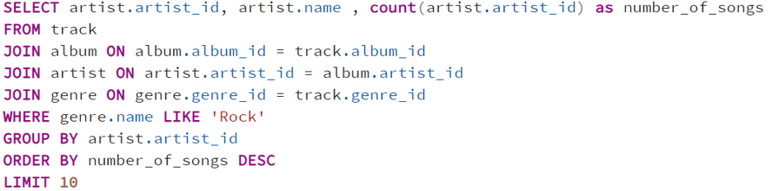
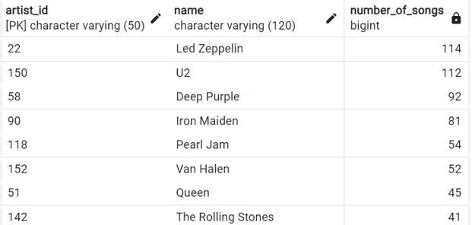
Moderate
Question : 2. Let's invite the artists who have written the most rock music in our dataset. Write a query that returns the Artist name and total track count of the top 10 rock bands

Slide 12
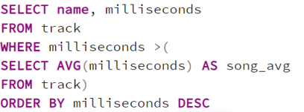
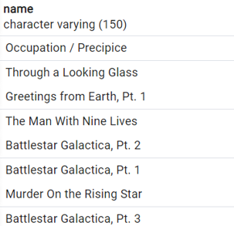
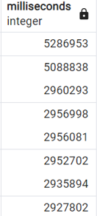
Moderate
Question :3. Return all the track names that have a song length longer than the average song length. Return the Name and Milliseconds for each track. Order by the song length with the longest songs listed first

Slide 13
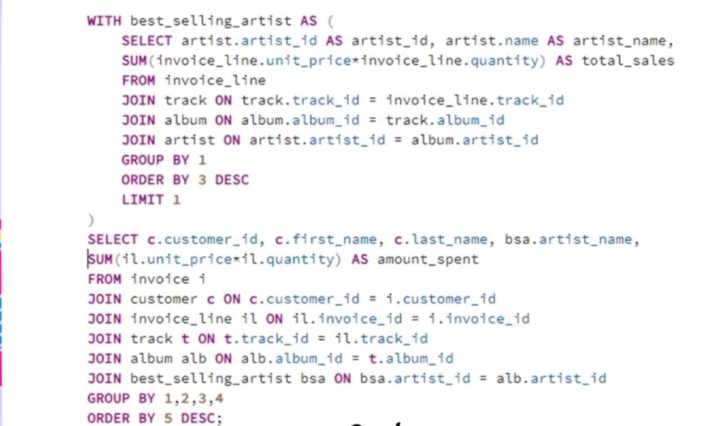
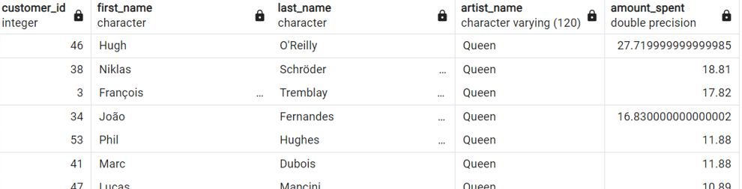
Advance
Question1. Find how much amount spent by each customer on artists? Write a query to return customer name, artist name and total spent
Query
Output

Slide 14
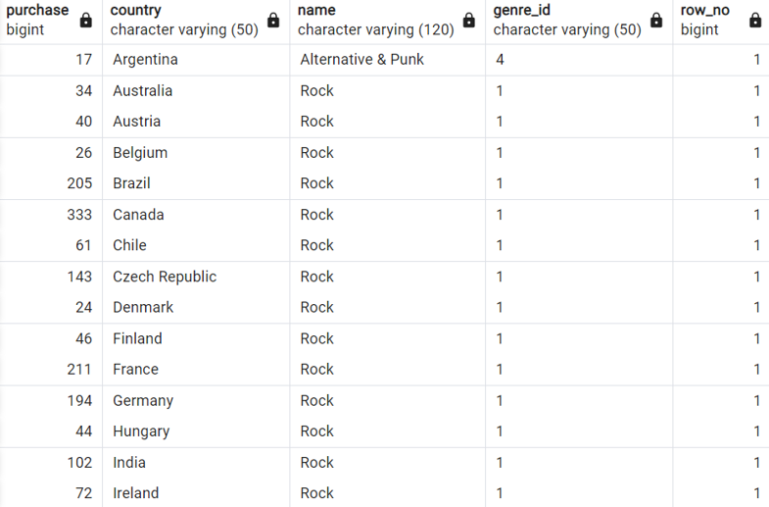
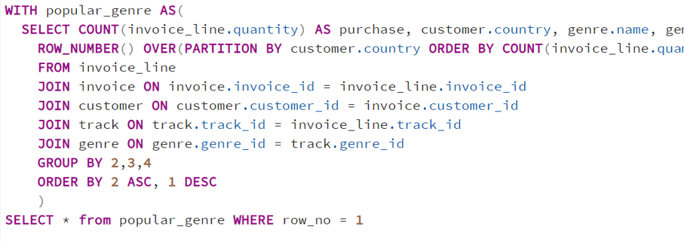
Advance
Question :2. We want to find out the most popular music Genre for each country. We determine the most popular genre as the genre with the highest amount of purchases. Write a query that returns each country along with the top Genre. For countries where the maximum number of purchases is shared return all Genres
Output
Query

Slide 15
—Thankyou
paraguchbagle@gmail.com

